Slide 1


TO ANALYSE THE EFFECT OF COVID-19 ON INDIVIDUALS’ PERSONALITY TRAITS AND THEIR SPENDING PATTERNS
Mentored By: MR.ANIMESH TIWARI
Submitted By : ANIRUDH REDDY ITIKELA
JAGTHAP ROHAN KUMAR
KAKARLA SRI RANGANADH
MEGHANA ANANTANENI
SHREYASHI TIWARI

Slide 2
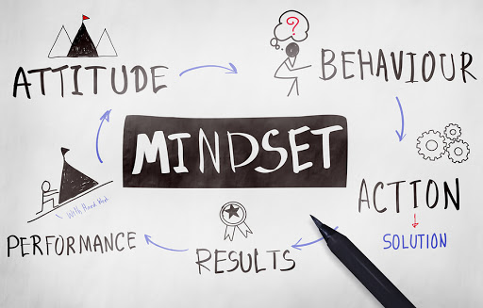
PSYCHOMETRICS
Psychometrics is the field of study concerned with the theory and technique of psychological measurement, which includes the measurement of knowledge, abilities, attitudes and personality traits.
DATASET
The dataset used was gathered by conducting a survey across locations and had questionnaires based on the psychological as well as the spending habits of individuals.
Survey Link: https://forms.gle/iYq7fv5hS8xaSZGb6
From the final responses, two datasets containing the information before COVID and present of sizes 551*43 and 551*45 were obtained.
The datasets consists of all the categorical features which were mostly on the likert scale.
Dataset Link: https://drive.google.com/file/d/1MeblsDp1F5Ryq1-oVkqPSfwx-RVPCeLK/view

Slide 3

PREPROCESSING
Misleading responses or anomalies in the data were identified by closely looking into the data based on individual’s employment status and income.
The encoding is done in such a way that it resulted in both ordinal and nominal columns based on the business significance they hold.
The null values accounted for approximately 2.6% of the entire data.
In order to deal with null values, concerning survey responses , the techniques explained in the research paper below were followed. https://www.ncbi.nlm.nih.gov/pmc/articles/PMC7045426/
IMPUTATION TECHNIQUES:
Hot-deck [KNN]
Multiple Imputation [MICE using r and python]
Imputation using Modelling [GRADIENT BOOST]

Slide 4
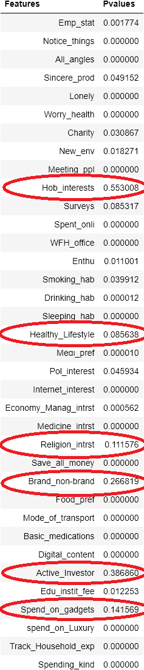
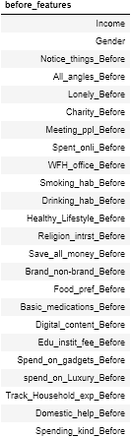
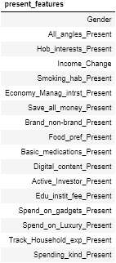
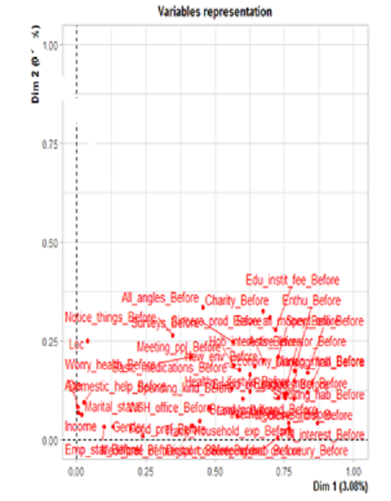
STATISTICS APPLIED
 | Chi-square test of Independence: The test was performed to identify the features which had significant relationship with the Target variable. | Multiple Correspondence Analysis(MCA): The procedure appears to be the counterpart of principal component analysis for categorical data. It is used to detect and represent underlying structures in a data set and is also used in dimensionality reduction.
Wilcoxon signed ranked test : The test was performed to capture the significant change (between before and Present situation). It was observed that 25 features had a significant change.

Slide 5
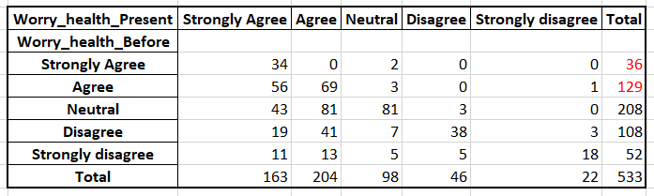
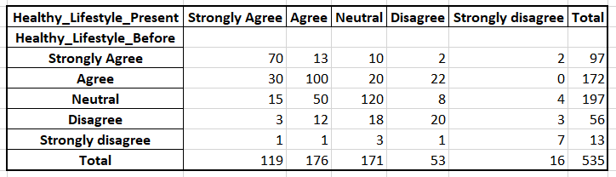
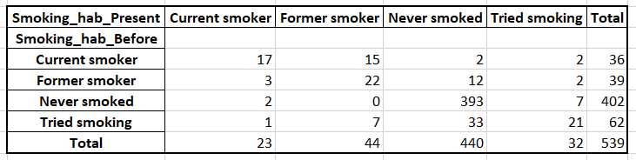
Exploratory Data Analysis
Transition Matrix for Worry_health
The analysis is done around “Maintaining Healthy Lifestyle” and “Smoking Habits”.
The total percentage of people who used to worry about their health:
((129+36)/542)*100 = 30.44%
The percentage of people worrying about their health currently:
((209+164)/542)*100 = 68.8%
49.6% people used to have a healthy lifestyle before which now shifted to 55%.
393 out of 403 people i.e., 90% people who didn’t have the habit of smoking before the pandemic are still continuing to maintain the same
Out of 36, 17 people i.e., 50% of the people who used to smoke before are still continuing to do so.
Transition matrix for Healthy_Lifestyle
Transition matrix for Smoking_hab

Slide 6
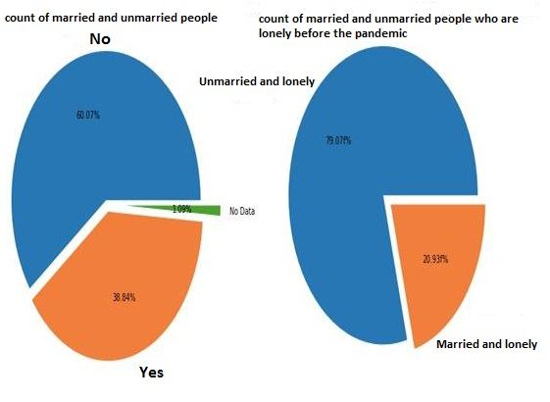
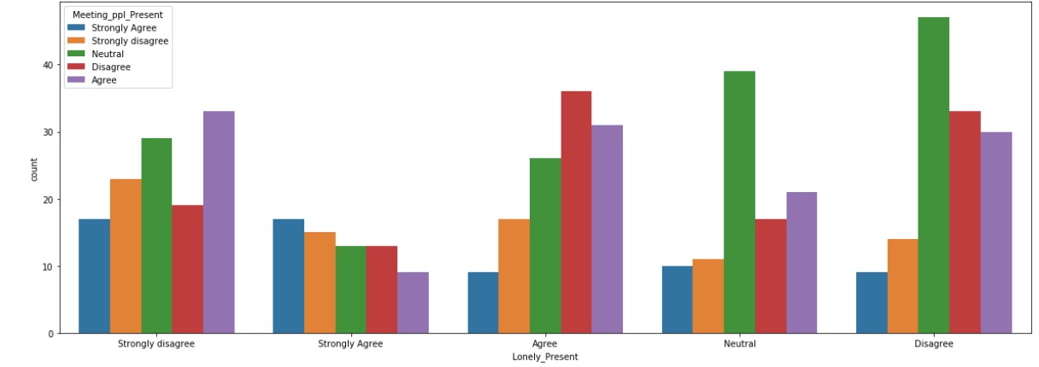
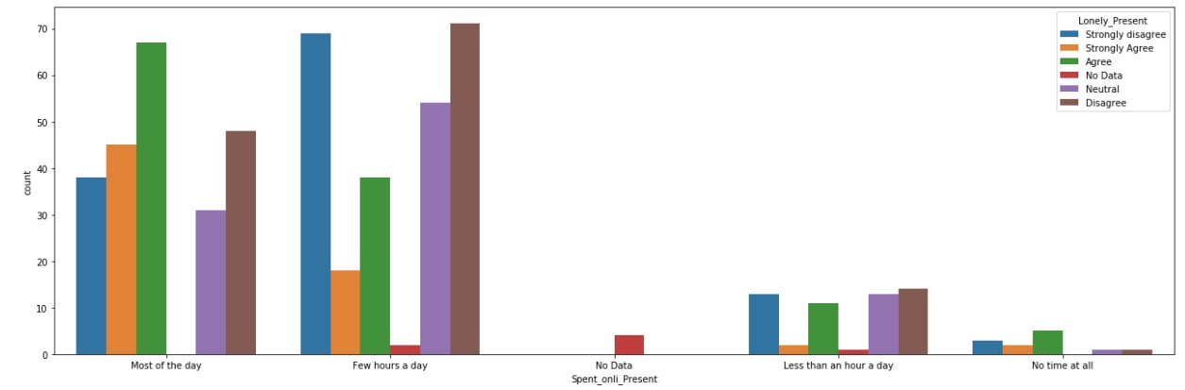
The analysis here is done around “I feel lonely in life” both before the pandemic and in the present situation , on the basis of Age, Income, Gender and Marital Status.
Fig 1
Fig1
Fig 2
Fig 3

Slide 7
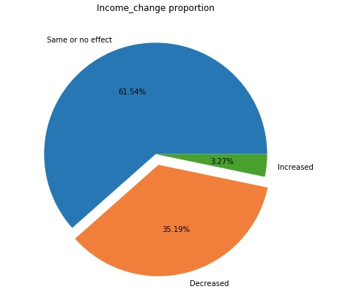
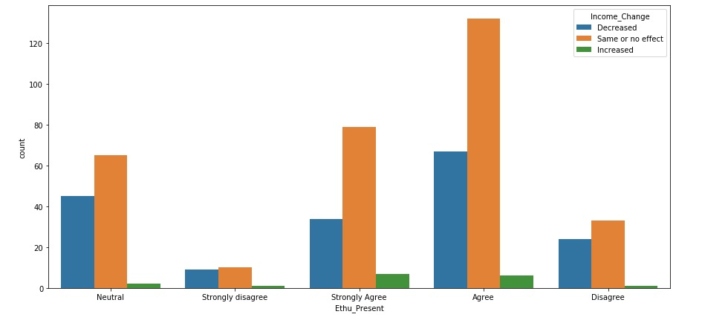
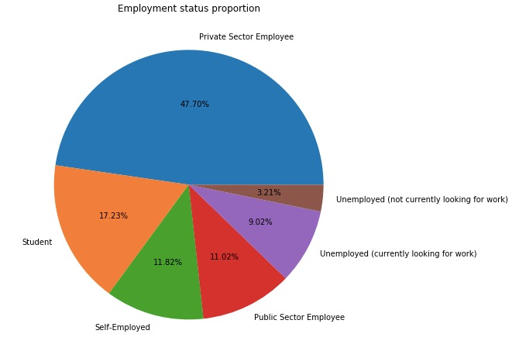
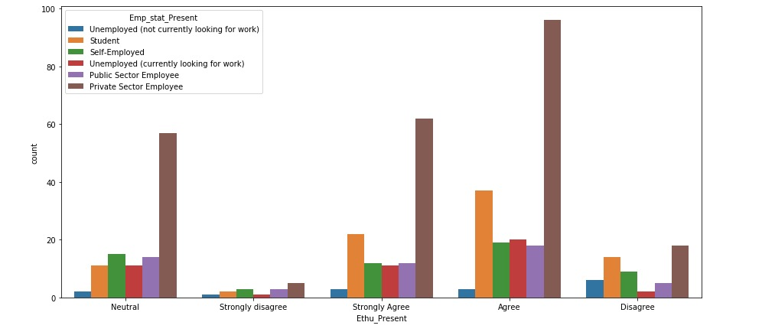
The analysis is done around “Enthusiasm to start something new or have a change in the usual”

Slide 8
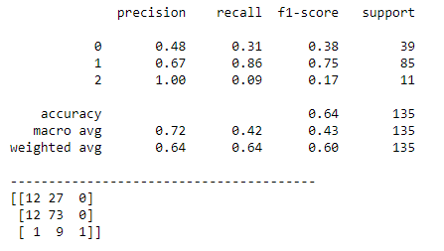
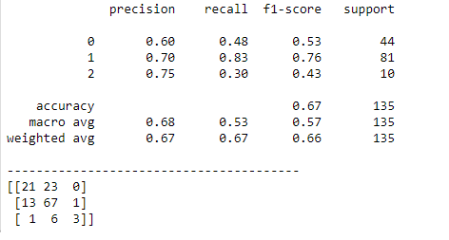
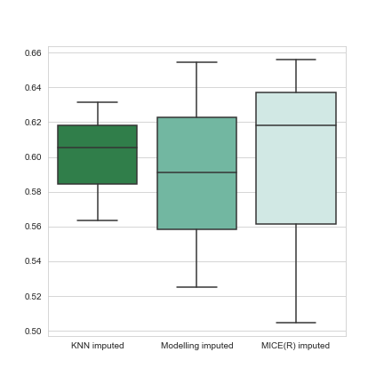
MODELLING(CLASSIFICATION)
LOW
MED
HIGH
Objective: Dealing this as a prediction problem(classification) and predicting what spending category(High/Medium/Low), a person with a set of characteristics in the present situation will belong to.
Decision tree was selected as the base model which gave us the test accuracy of 57%. The model was biased towards predicting the “medium spending” category. (Imbalanced dataset)
KNN and Random Forest models were built and test accuracies of 54% and 59% respectively, were achieved.
Gradient Boost gave the test accuracy of 66% and was able to classify the “high spending” category comparatively better than the other models. This can be due to the fact that gradient boost learns from the past errors. Therefore, the influence of imbalanced data is the least. (Training accuracy:60%)
From all the classification reports (DT, RF, KNN, GB), it has been observed that the scores for the “high spending” category are least indicating that people are not spending much and are tending to save money.
Random Forest
LOW
MED
HIGH
Gradient Boost
Gradient boost performance

Slide 9
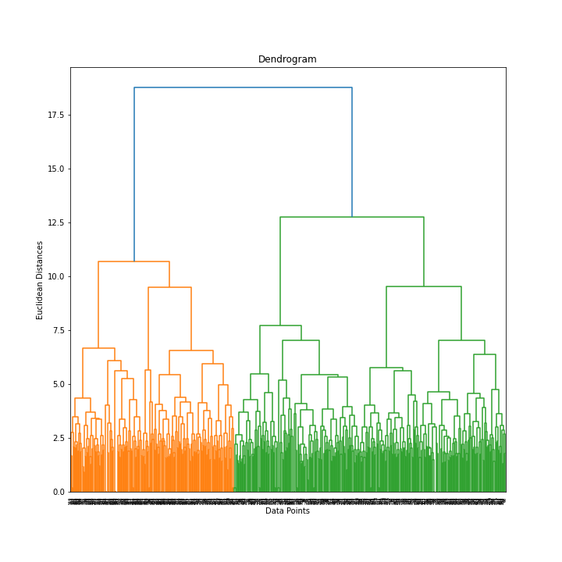
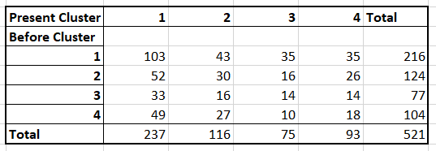
MODELLING (CLUSTERING)
To achieve our clustering objective of observing dominant personalities (with respect to interests, preferences and spending patterns) before COVID and how did it change in the present situation.
K-Means :
Before: Maximum silhouette of 0.28 with three clusters, with an inertia of 1515.73 has been observed for the before situation.
Present: Silhouette score of 0.26 with five clusters, with an inertia of 1055 were seen.
Hierarchical(Agglomerative) Clustering: Silhouette score of 0.266 with three clusters were observed.
K-Modes: For both the datasets, four clusters with a cost of 22 were seen.
Even though overlapping clusters were formed but the traces of patterns found are a positive sign indicating the feasibility of clustering technique to the field of behavioural analysis.
Agglomerative clustering(Before)
Clustering transition matrix

Slide 10
DRAWBACKS
Behavioural and economical analysis done is subject to time.
Questionnaire preparation
Respondent’s transparency
Data collected is subject to regional, age and occupational bias
VISION
Potential questionnaires with the help of domain experts
Ideal techniques to deal with a multi variate categorical dataset(Mice, Fisher’s Test, MCA etc)
Optimised Data collection (Sampling techniques)
NLP or advanced Concepts for sentiment analysis
APPLICATIONS
Educational Institutions
Private Sectors
Analysing criminal mindset
This analysis can be extended to respective industries

Slide 11
THANK
YOU!

